Slide 1

Hiring Process Analytics
Indu Prakash

Slide 2
Data Analytics Tasks
Hiring Analysis
Salary Analysis
Salary Distribution
Departmental Analysis
Position Tier Analysis
Presentation Title

Slide 3

Hiring Analysis
Determine the gender distribution of hires. How many males and females have been hired by the company?

Slide 4

Salary Analysis
What is the average salary offered by this company? Use Excel functions to calculate this.

Slide 5
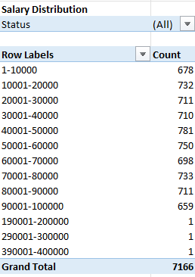
Salary Distribution
Create class intervals for the salaries in the company. This will help you understand the salary distribution.

Slide 6
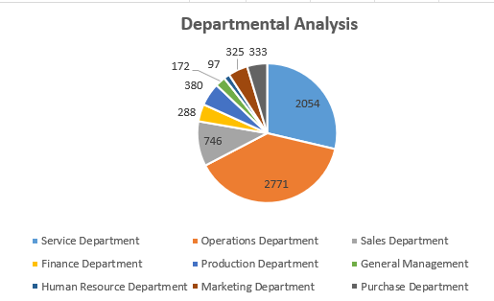
Departmental Analysis
Use a pie chart, bar graph, or any other suitable visualization to show the proportion of people working in different departments.

Slide 7
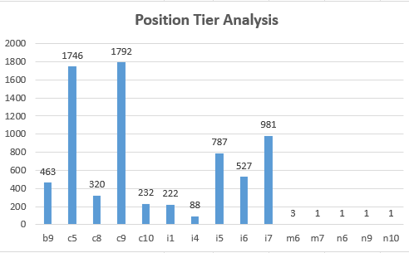
Position Tier Analysis
Use a chart or graph to represent the different position tiers within the company. This will help you understand the distribution of positions across different tiers.

Slide 8




Thank you

